Slide 1

腦筋急轉彎
猜猜看
start

Slide 2


阿拉丁有幾個哥哥？
one
two
three

Slide 3
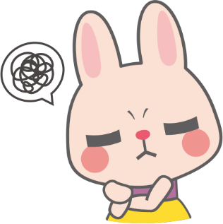
答錯了
try

Slide 4
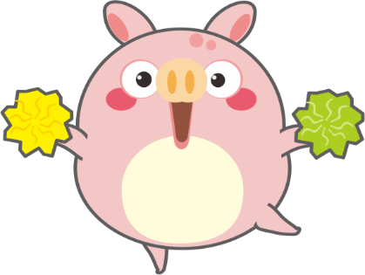
恭喜你
答對了
bye

