Slide 1
!!哈哈 哈!!
模林召喚
!!!!!!!!!!!!!!!!!!!!!!!!!!!!!!!!!!!!!!!!!!!!!!!!!!!!!!!!!!!!!!!!!!!!!!!!!!!!!!!!!!!!!!!!!!!!!!!!!!!!!!!!!!!!!!!!!!!!!!!!!!!!!!!!!!!!!!!!!!!!!!!!!!!!!!!!!!!!!!!!!!!!!!!!!!!!!!!!!!!!!!!!!!!!!!!!!!!!!!!!!!!!!!!!!!!!!!!!!!!!!!!!!!!!!!!!!!!!!!!!!!!!!!!!!!!!!!!!!!!!!!!!!!!!!!!!!!!!!!!!!!!!!!!!!!!!!!!!!!!!!!!!!!!!!!!!!!!!!!!!!!!!!!!!!!!!!!!!!!!!!!!!!!!!!!!!!!!!!!!!!!!!!!!!!!!!!!!!!!!!!!!!!!!!!!!!!!!!!!!!!!!!!!!!!!!!!!!!!!!!!!!!!!!!!!!!!!!!!!!來猜啊
你 過 來 阿!!!!!!!!!!!!!!!!!!!!!!!!!!!!!!!!!!!!!!!!!!!!!!!!!!!!!!!!!!!!!!!!!!!!!!!!!!!!!!!!!!!!!!!!!!!!!!!!!!!!!!!!!!!!!!!!!!!!!!!!!!!!!!!!!!!!!!!!!!!!!!!!!!!!!!!!!!!!!!!!!!!!!!!!!!!!!!!!!!!!!!!!!!!!!!!!!!!!!!!!!!!!!!!!!!!!!!!!!!!!!!!!!!!!!!!!!!!!!!!!!!!!!!!!!!!!!!!!!!!!!!!!!!!!!!!!!!!!!!!!!!!!!!!!!!!!!!!!!!!!!!!!!!!!!!!!!!!!!!!!!!!!!!!!!!!!!!!!!!!!!!!!!!!!!!!!!!!!!!!!!!!!!!!!!!!!!!!!!!!!!!!!!!!!!!!!!!!!!!!!!!!!!!!!!!!!!!!!!!!!!!!!!!!!!!!!!!!!!!!!!!!!!!!!
GOGO

Slide 2


我最愛的遊戲
第五
船說
急速
MINECRAFT
上一頁
SWICH
往者
^.^
濕濕濕雌

Slide 3
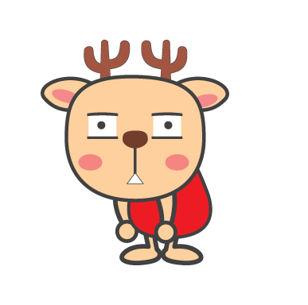

答對了嗎??????????????
重來

Slide 4


嗯嗯!!!!!!!!!!!!!!!!!!!!!!!!!!!!!!!!!!!!!!!!!!!!!!!!!!!!!!!!!!!!!!!!!!!!!!!!!!!!!!!!!!!!!!!!!!!!!!!!!!!!!!!!!!!!!!!!!!!!!!!!!!!!!!!!!!!!!!!!!!!!!!!!!!!!!!!!!!!!!!!!!!!!!!!!!!!!!!!!!!!!!!!!!!!!!!!!!!!!!!!!!!!!!!!!!!!!!!!!!!!!!!!!!!!!!!
88

